Slide 1

Project Title – AirBnb Hotel Booking Analysis
Samyak Shitalchand Dahale
ID:- AICTE_VOIS OL 4001-6727-906

Slide 2

PROBLEM STATEMENT
Focus Area – NYC Dataset
Study Innovative Business Model
Explore Airbnb’s Market Dynamics
Insight into NYC’s Lodging Trends
Significant insights for stakeholders.
Out job is to uncover patterns and key drivers behind Airbnb’s performance in New York City.
helping understand market behavior, customer preferences, and pricing dynamics within the modern hospitality industry.

Slide 3
Project Description
Used the Airbnb NYC dataset to study listings, prices, and availability.
Cleaned the data by removing missing and duplicate records.
Performed exploratory analysis to find key patterns and trends.
Visualized insights on pricing, location, and host activity using Python tools.
Explored what affects customer satisfaction and demand.
Shared useful insights to help hosts, guests, and stakeholders make better decisions.
Notebook link

Slide 4

WHO ARE THE END USERS?
Hosts & Guests
Investors/ Shareholders
Tourism & Hospitality Analysts
City Planners & Policy Makers

Slide 5





Technology Used
Python (libraries:- Pandas, Matplotlib, Numpy, Seaborn
Excel / CSV Dataset
Google Colab (for execution)
Github

Slide 6
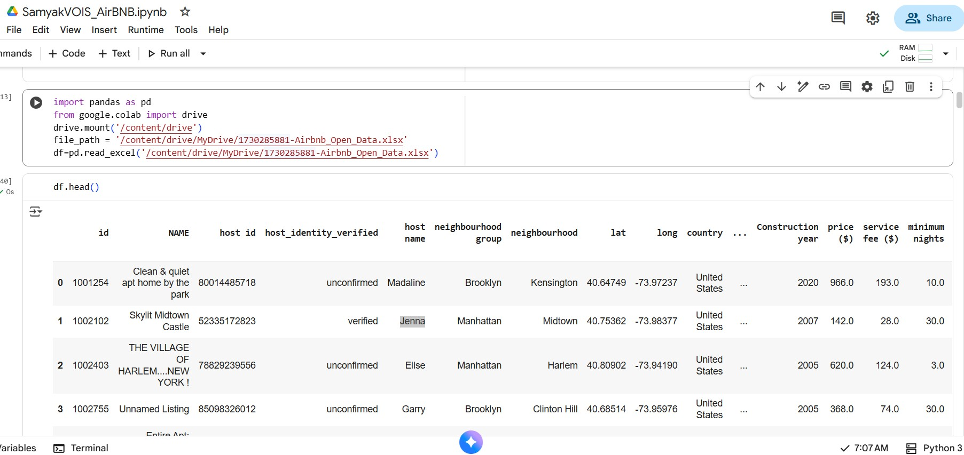
RESULTS1
[Add screen shots of your code or Chart(s) ]
Demo Link

Slide 7
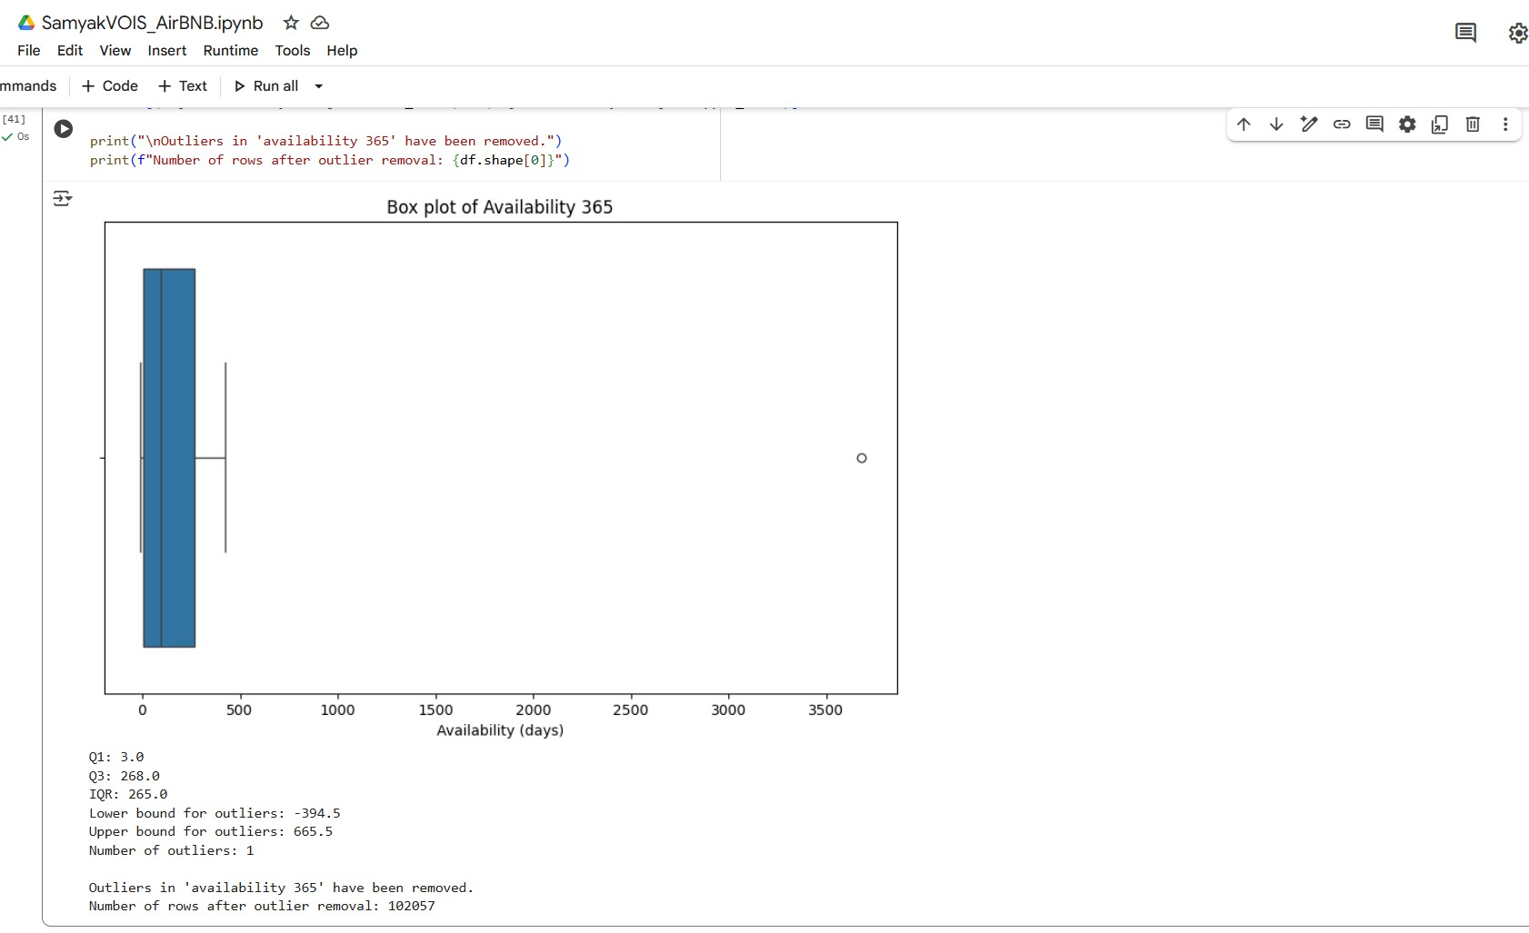
RESULTS2
[Add screen shots of your code or Chart(s) ]
Demo Link

Slide 8
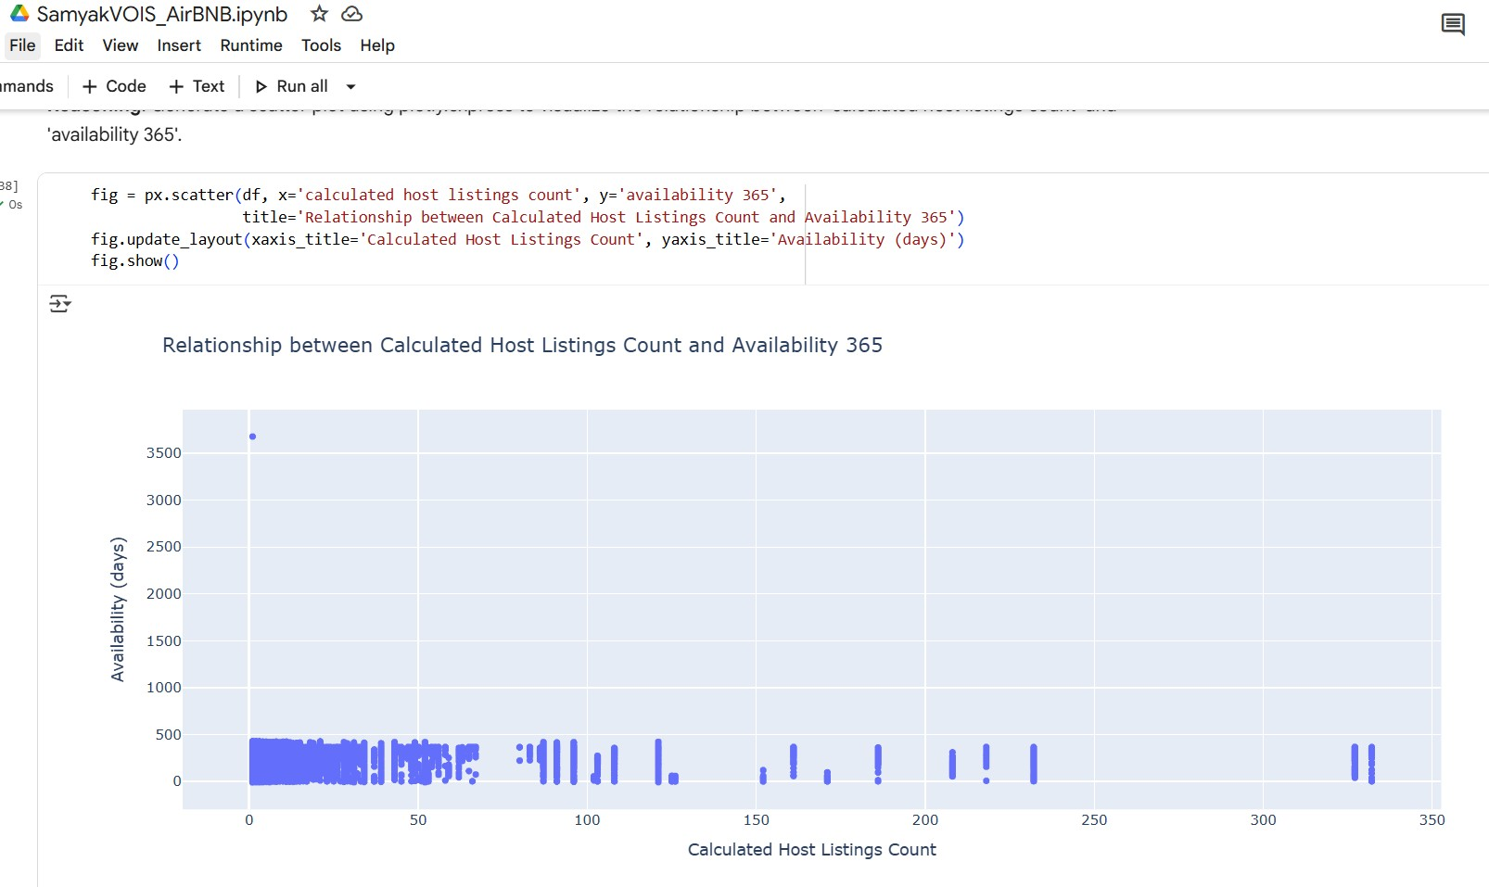
RESULTS3

Slide 9
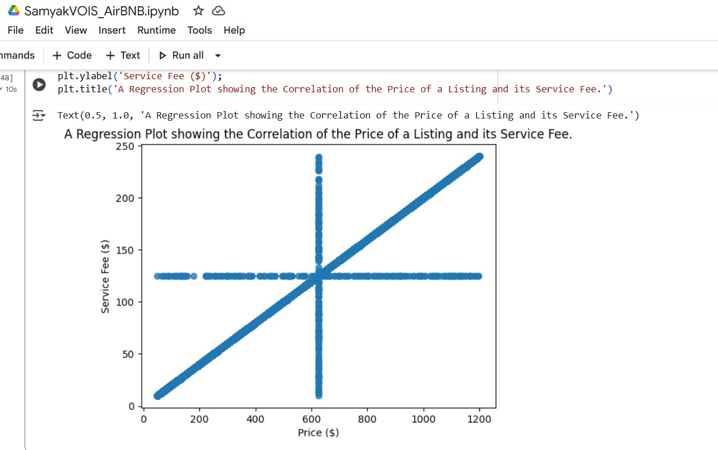
RESULTS4

Slide 10
GitHub repository
https://github.com/SamyakDahale/VOIS_AICTE_Oct2025_SamyakDahale.git
Link

Slide 11
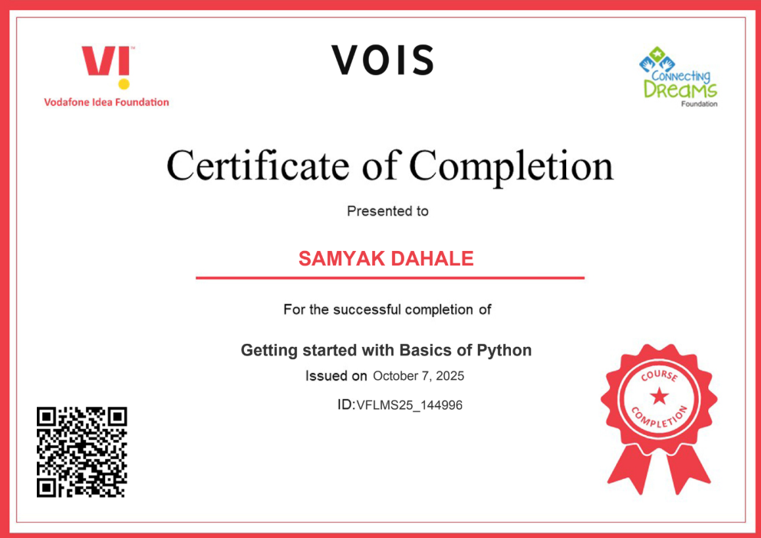
Getting started with Basics of Python Certificate

Slide 12
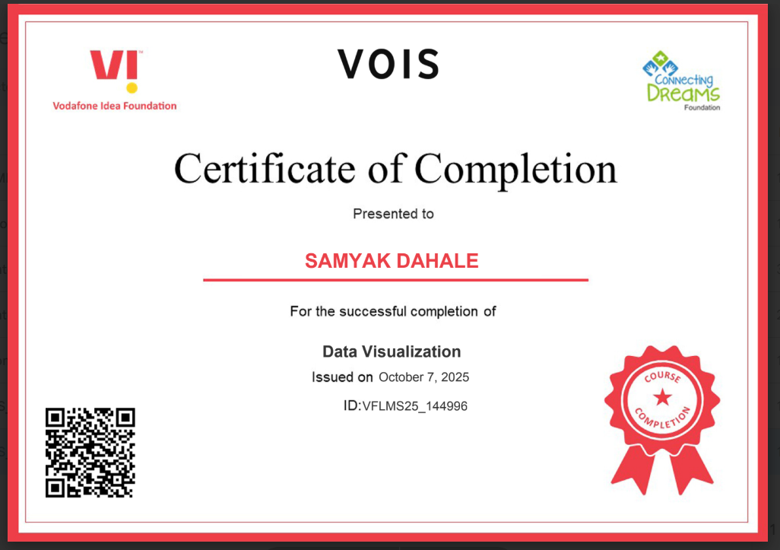
Data Visualization Certificate
[Paste your Certificate Here]

Slide 13

Thank you
.
.

